Slide 1

WAY TO ENTERPRISE
Java Basics
VTI ACADEMY
Author: duy.nguyenngoc1@vti.com.vn
March 2020

Slide 2
Agenda
Web architecture
Setup software
Datatype
Enum
Array
Init Object
Assignments
Copyright © VTI Academy All Rights Reserved

Slide 3
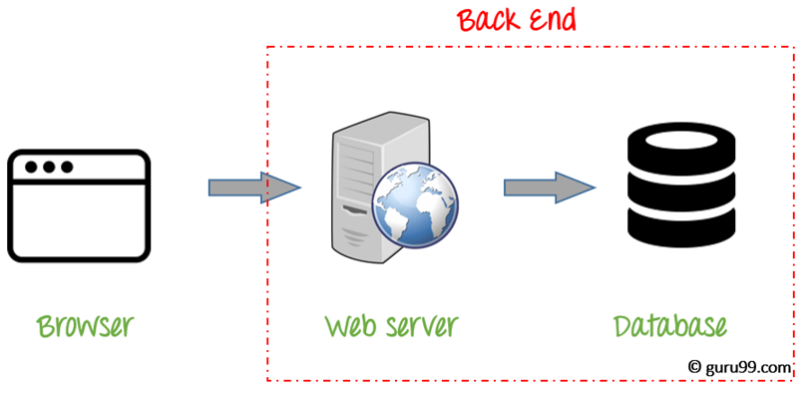
Web architecture

Slide 4
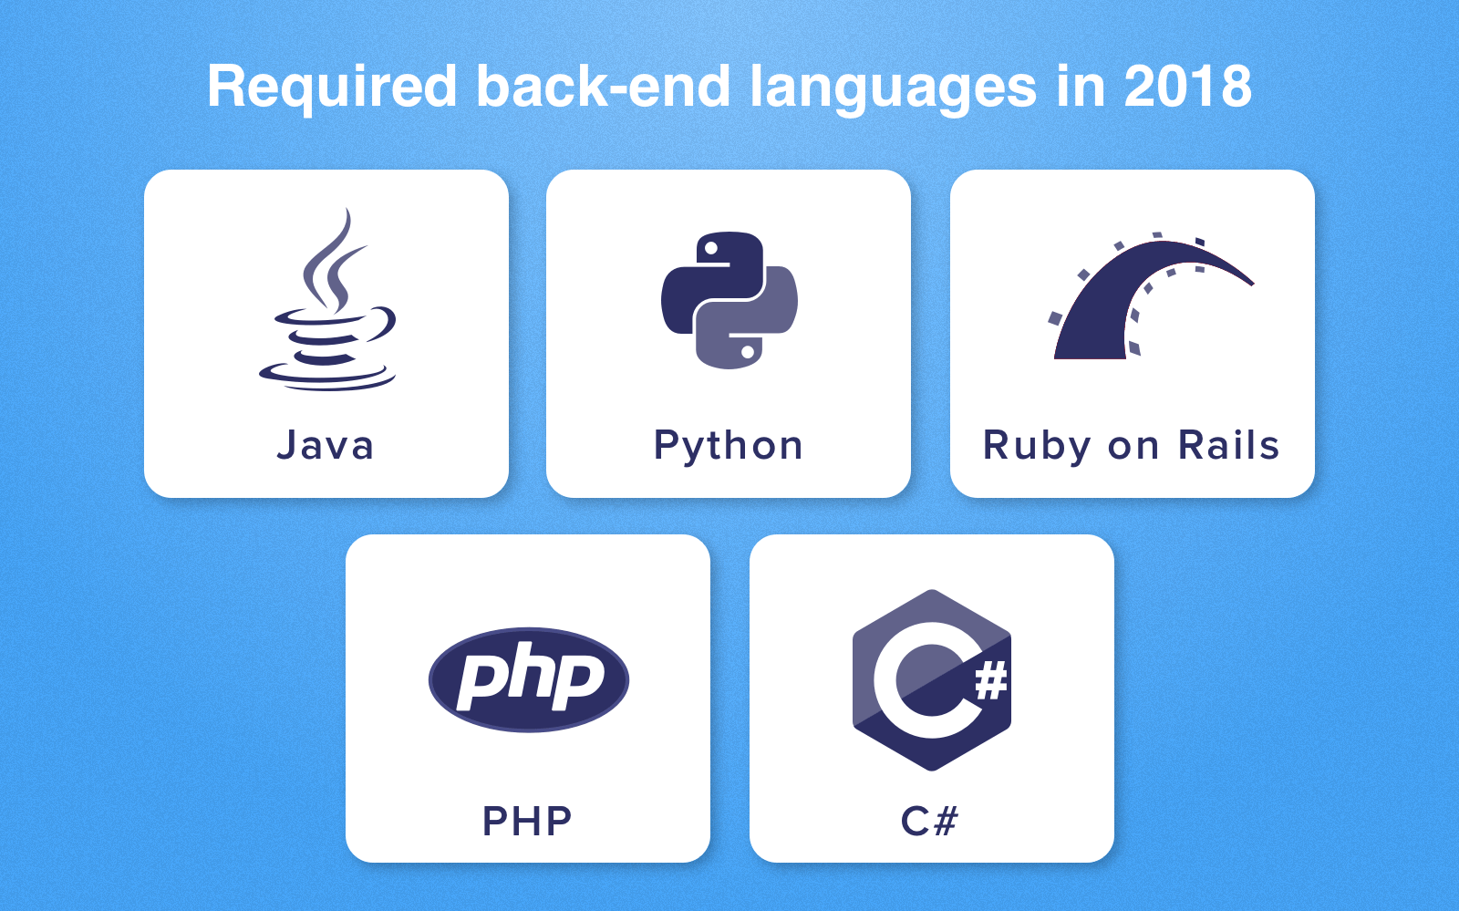
Popular Language

Slide 5
Setup Software
JDK
Eclipse IDE
https://drive.google.com/open?id=1nlmNi9521yfaskEwi3wB5dW3DFUw7VeT

Slide 6
Datatype
Primitive
String
Date
Enum
Array

Slide 7
Primitive
Integer
Real number
Characters
Boolean

Slide 8
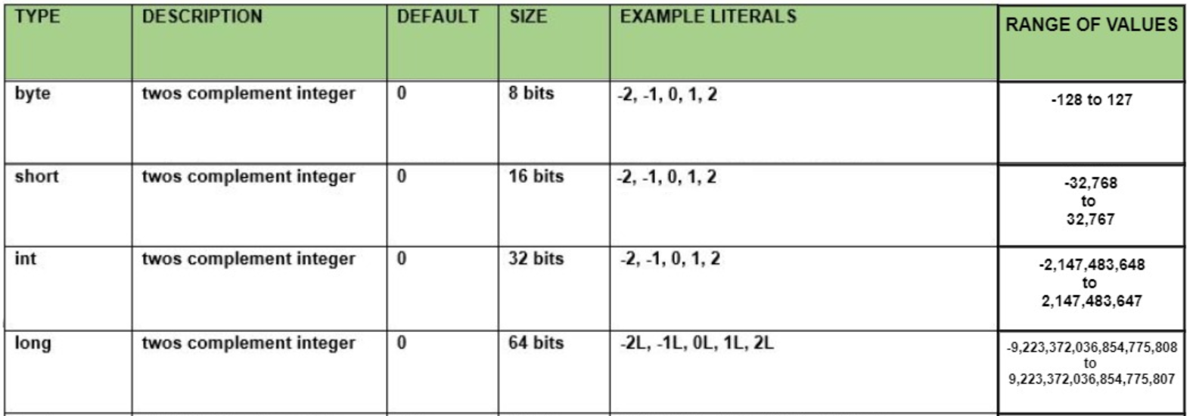
Integer

Slide 9
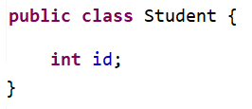
Example
Ex:

Slide 10
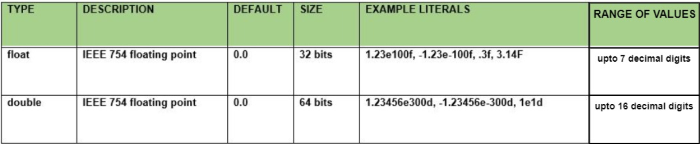
Real Number

Slide 11
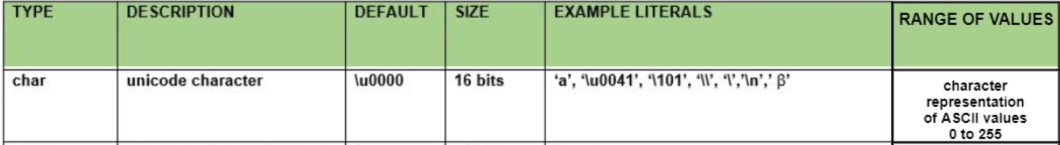

Characters
Char
String

Slide 12
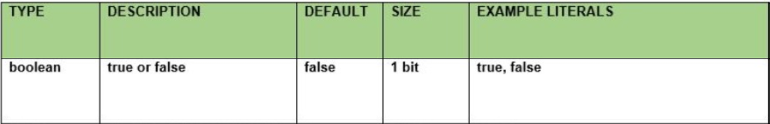
Logic

Slide 13
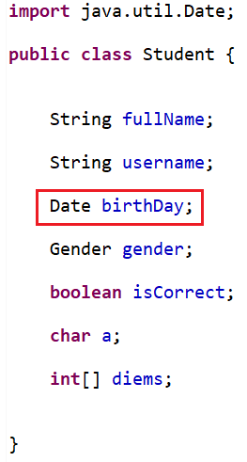
Date
Date
LocalTime

Slide 14
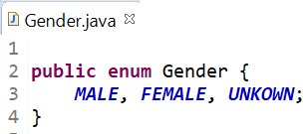
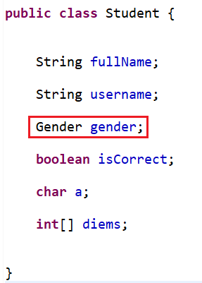
Enum

Slide 15

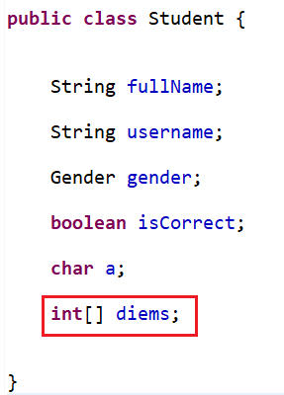
Array
Init
EX:

Slide 16
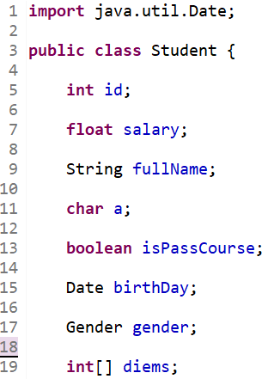
Naming rules
Property is noun
Capitalize each character of the word except the first word
The boolean data type has the first character is "is" character
Enum: Capitalize all characters

Slide 17
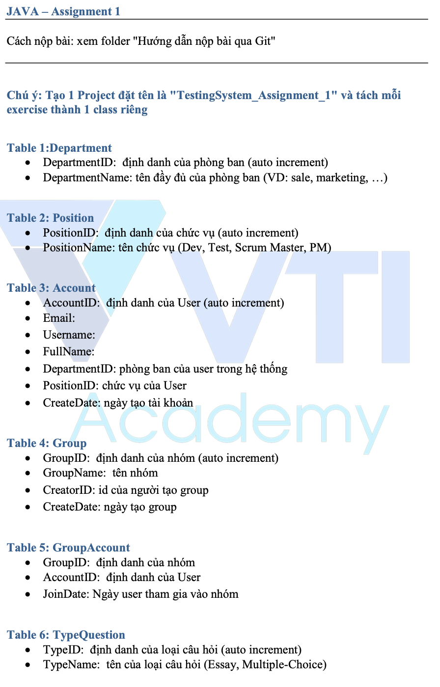
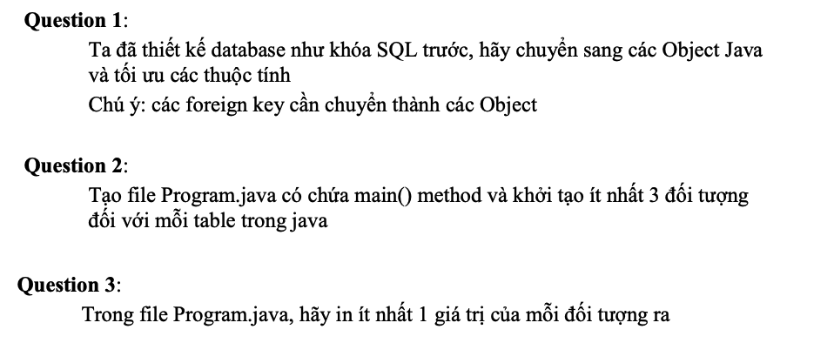
Testing System Assignments
Question 1

Slide 18
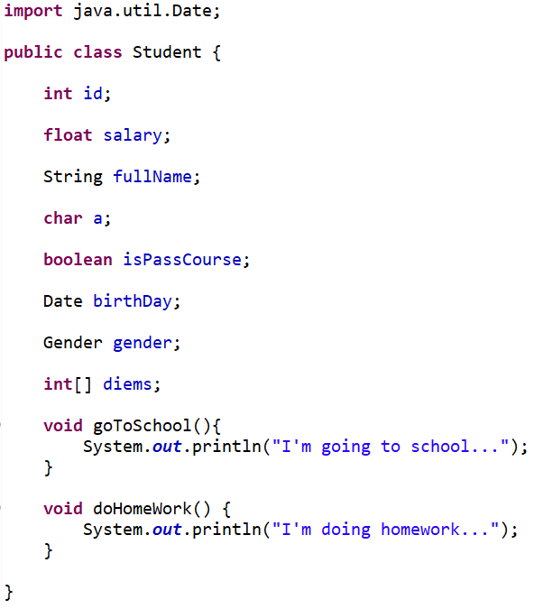
Object
Property
Method

Slide 19
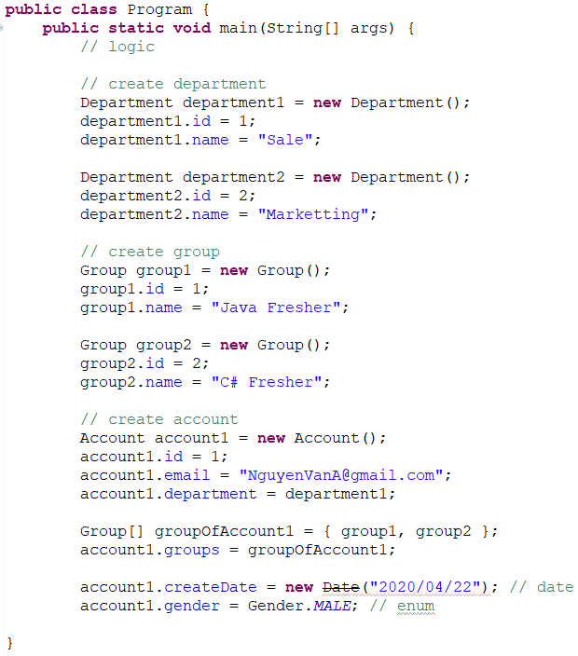
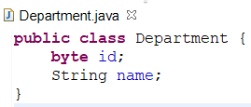
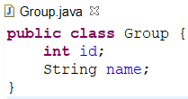
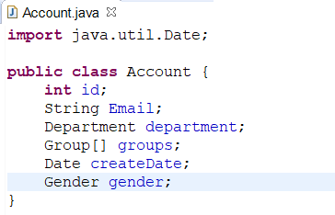
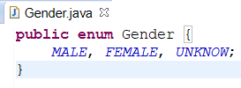
Init Object

Slide 20
Testing System Assignments
Question 2

Slide 21
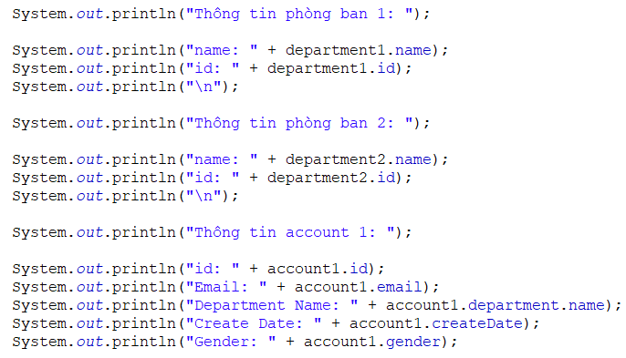
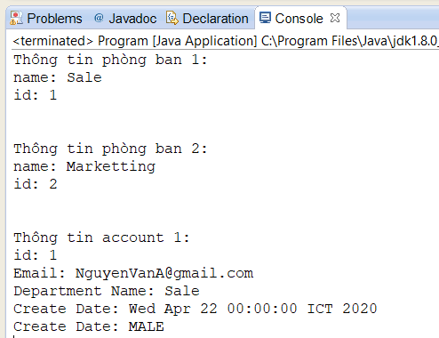
Print value

Slide 22
Testing System Assignments
Question 3

Slide 23
Testing System Assignments

Slide 24
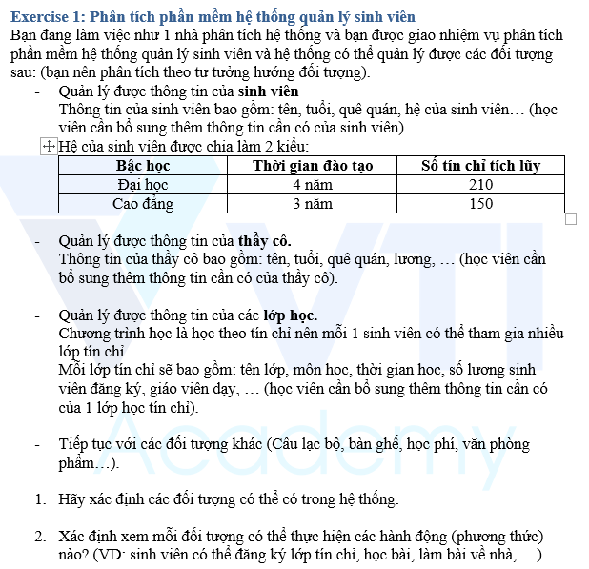
Extra Assignments

Slide 25
Q & A
Copyright © VTI Academy All Rights Reserved

